Slide 1
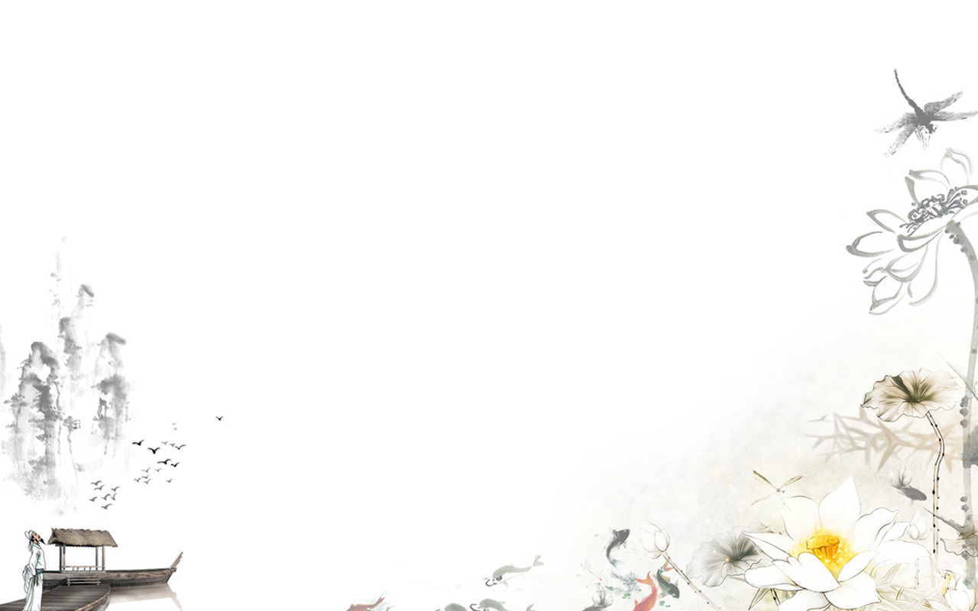

1. To learn some new words: worse, service, pretty, menu, act, meal…
2. To learn the usage of the superlatives.

Slide 2


Introduce the three movie theaters to your partner.
Poly cinema has the biggest screens.
Wanda cinema is the most popular.
Bona cinema has the shortest waiting time.
…

Slide 3
Fill in the blanks according to the conversation.
Greg is _______ in town. He doesn’t know his way _______. Helen is telling him some information now. The _______ supermarket is on Center Street. He can buy _______ _______ food there. The ________ cinema around here is Sun Cinema. He can sit _______ ________ __________ because they have _______ ________ seats.
new
around
best
the
freshest
newest
the
most
comfortably
the biggest
Now role-play the conversation.

Slide 4

形容词/副词最高级用法：(记笔记)
1) 形容词最高级前一般要加the, 但如果其前有形容词性物主代词或名词所有格等修饰语时, 则不用加the。
e.g. Her youngest daughter is eleven years old.
2) 副词最高级前面可以加the, 也可以省略。
e.g. Liu Jun ran (the) fastest in the race.

Slide 5

Unit 4

Slide 6
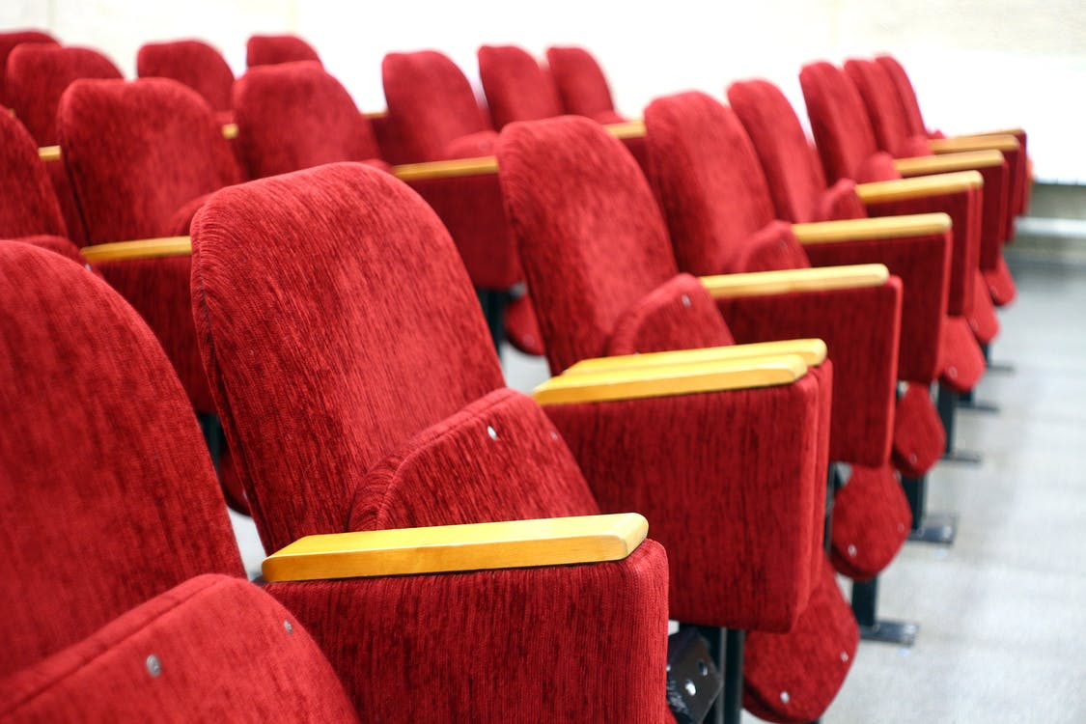
Unit 4
What's the best movie theater?

Slide 7
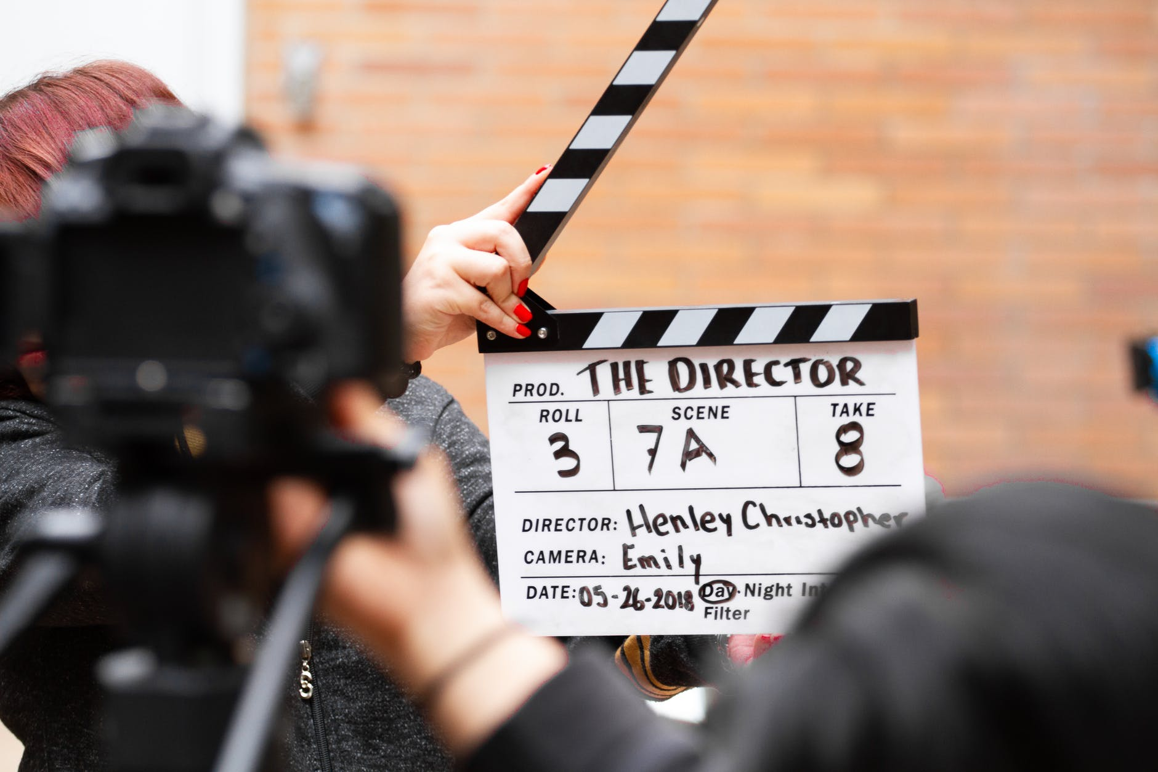


Slide 8

Translation
Fill in the blanks.
1. A: What’s the _______ _______ _______ (最好的电影院) to go to?
B: Town Cinema. It’s the ________ ______ ______ (离家最近). And you can buy tickets _______ ________ _______ (最快地) there.
best movie theater
closest to home
the most quickly

Slide 9
2. A: Which is ______ ______ (最差的) clothes store in town?
B: Dream Clothes. It’s _______ _______ (比……差一些) Blue Moon. It has ______ ______ ______ (最差的服务).
the worst
worse than
the worst service
3. A: What do you think of 970 AM(频道)?
B: I think 970 AM is _______ _______ (十分差). It has _______ ________ _______ (最差的音乐).
pretty bad
the worst music

Slide 10
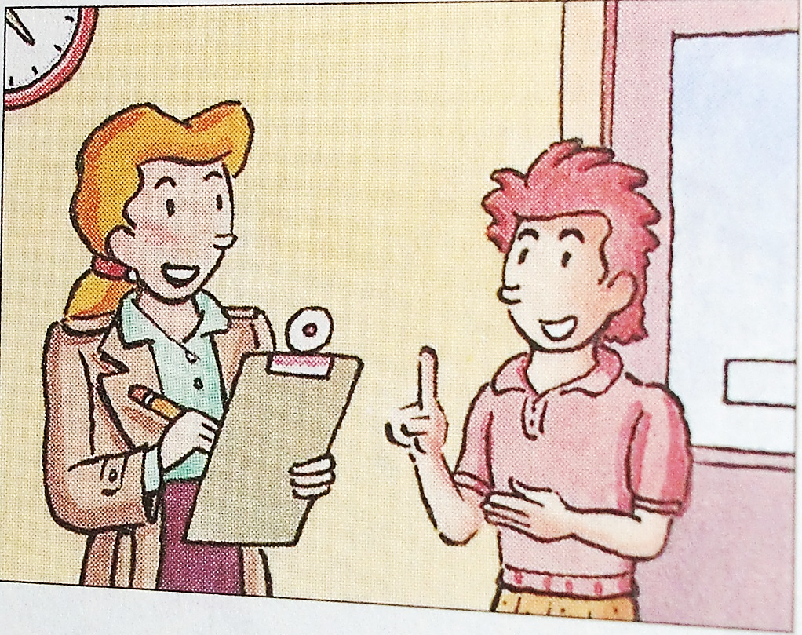
Let’s listen!
Look at the picture. A reporter is interviewing(采访) a boy about the best clothes store and the best radio station(广播电台) in Green City.

Slide 11


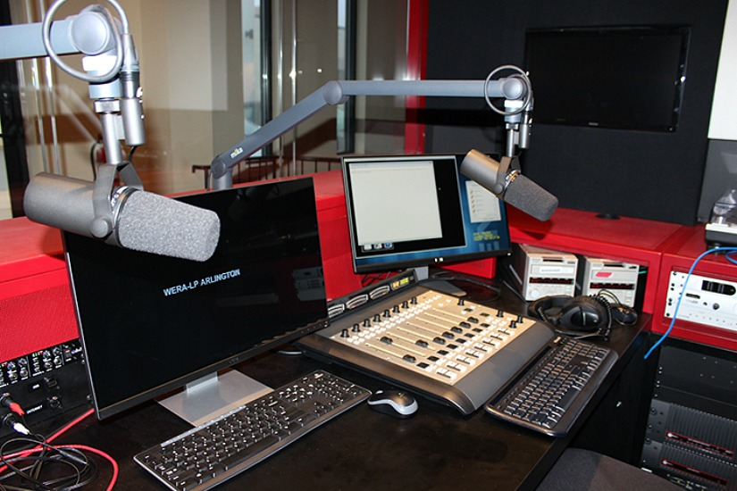
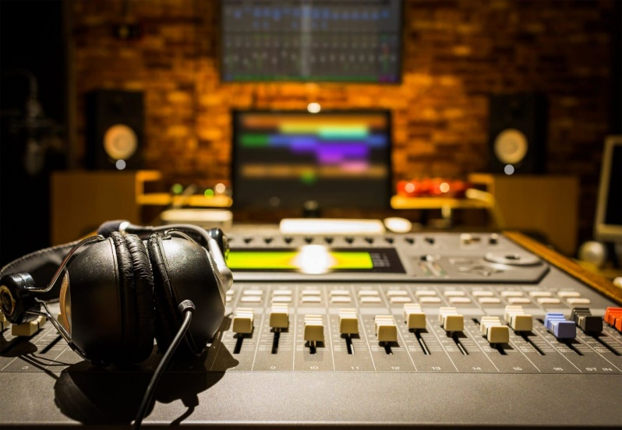
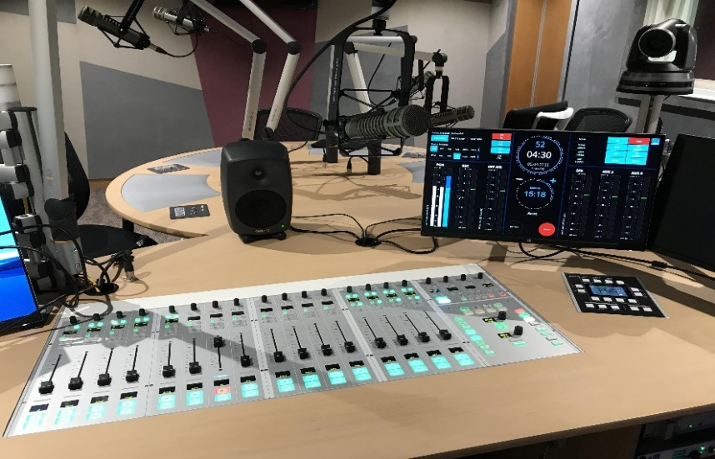
Listen to their conversation. Circle the boy’s answers.
Green City Survey
Which is the best clothes store?
a. Miller’s b. Blue Moon c. Dream Clothes
2. Which is the best radio station?
a. 970 AM b. 97.9 FM c. 107.9 FM

Slide 12

Listen again. Write the correct store or radio station next to each statement.
_____________ It’s the most expensive.
_____________ It has the best clothes.
_____________ It’s the worst store.
_____________ You can buy clothes the most cheaply there.
Blue Moon
Clothes stores
Miller’s
Miller’s
Blue Moon
Dream Clothes
Dream Clothes
Miller’s
Radio Stations
_________ It has the worst music.
_________ They play the most boring songs.
_________ The DJs choose songs the most carefully.
_________ It’s the most popular.
970 AM
97.9 FM
107.9 FM
970 AM
97.9 FM
107.9 FM
97.9 FM

Slide 13
Read the conversations.
Reporter: What’s the best clothes store in Green City?
Boy: Miller’s is the best. It has the best clothes and you can buy clothes the most cheaply there.
Reporter: What do you think about the other stores?
Boy: Well, Blue Moon is in a fun part of town, but it’s the most expensive. And Dream Clothes is worse than Blue Moon. It has the worst service in town. It’s the worst store.

Slide 14
Reporter: OK. What about radio stations?
Boy: 107.9 FM is the best. The DJs choose songs the most carefully. They always play the most interesting music.
Reporter: What about the other radio stations?
Boy: Well, I think 970 AM is pretty bad. It has the worst music.
Reporter: I heard that 97.9 FM is the most popular.
Boy: Yes, it is, but I think they play the most boring songs.
adv. 相当; 十分; 很

Slide 15

There is a dialogue between Greg and Helen.
Greg is new in town. Helen is one of his warm-hearted neighbors.
Read the conversation and answer the questions.
热心的邻居
1. How does Greg like the town?
2. What does Helen tell Greg about the town?
He thinks it’s fantastic, but he doesn’t know his way around.
She tells Greg about the best supermarket and the newest cinema.

Slide 16
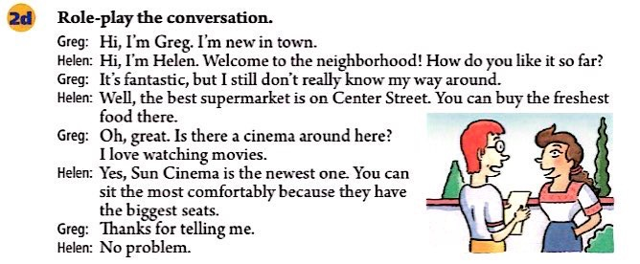


Slide 17
Can you find the rules?
形容词/副词最高级用法
e.g. Her youngest sister is eleven years old.
e.g. Jane’s youngest sister is eleven years old.
e.g. Liu Jun ran fastest in the race.
1) 形容词最高级前一般要加the, 但如果其前有形容词性物主代词或名词所有格等修饰语时, 则不用加the。
2) 副词最高级前面可以加the, 也可以省略。

Slide 18
3) 形容词和副词的最高级常与介词短语连用, 说明比较的范围。
一般情况下, 如果主语与介词短语中的名词属于同一类, 用of;
如果不是同一类, 用in。
e.g. Jim jumps (the) highest of all the boys.
e.g. Tina is the most outgoing in her family.
4) 有时最高级和比较级可以转换。
e.g. This car runs (the) fastest of all the cars.
= This car runs faster than other cars.
/This car runs faster than any other car.

Slide 19


Fill in the blanks with the correct forms of the words in brackets.
1. We went to the ______ (bad) restaurant in town last night. The menu had only 10 dishes and the service was not good at all!
2. Blue Moon is ______ (good), but Miller’s is ________ (good) in town.
worst
n. 菜单
n. 服务
good
the best

Slide 20
more expensive
3. The Big Screen is _______________ (expensive) than most cinemas, but Cinema City is _________________ (expensive).
4. Movie City has the _______ (bad) service, but we can sit the ________________ (comfortably) there.
the most expensive
worst
most comfortably
best
5. Tom acted the _______ (well) in that movie. I think he’s much _______ (good) than other actors. He can always find the _______________ (interesting) roles to play.
better
most interesting
v. 扮演
n.角色

Slide 21

Think of three restaurants for lunch near your home. Fill in the chart. Then talk in your group and choose the best one.
Danny’s is the best one because it’s the closest.
Restaurants | Danny’s
How much is a meal? | 100 yuan
How far is it from your home? | 10 minutes by bus
Is the service good? | Yes, it is.
Is the food good? | Yes, it’s yummy.

Slide 22


Slide 24
Look at the sentences, pay attention to the colored expressions.
It has the biggest screen.
The Moon Theater has the friendliest service.
It’s the closest to home.
You can buy the freshest food there.
What’s the best clothes store in town?

Slide 25
I think the Moon Theater has the most comfortable seats.
It’s the most popular here.
You can buy clothes (the) most cheaply here.
It’s the most expensive.
The DJs choose songs (the) most carefully.

Slide 26


形容词和副词的最高级
最高级表示“最……”，表示三者或三者以上(人或物)进行比较，其中一个在某一方面超过其他几个。
1. 构成
一般情况下，形容词和副词的最高级的规则变化是在词尾加-est或在其前加most构成，不规则变化则要牢记。

Slide 27
规则变化
原形
最高级
规则
quick quickest
fresh freshest
(词尾加-est)
close closest
(以不发音的字母e结尾的加-st)
(重读闭音节词词尾只有一个辅音字母时, 先双写辅音字母再加-est)
big biggest

Slide 28
原形
最高级
规则
early earliest
(以辅音字母+y结尾的双音节词，变y为i加-est)
comfortable most comfortable
(多音节词和部分双音节词前加most)
cheaply (the) most cheaply
carefully (the) most carefully
(以ly结尾的副词的最高级是在其前面加 the most; the可以省略。)

Slide 29
不规则变化
good — best
little — least
bad / badly — worst
many / much — most
far — farthest / furthest
(不规则变化需专门记忆)

Slide 30

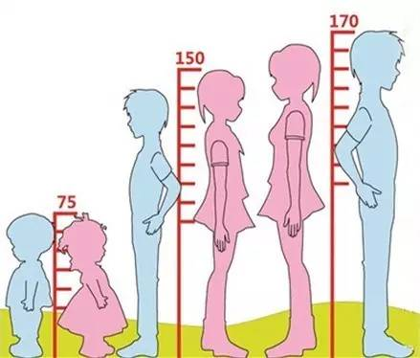
160
Linda 160 cm
Nancy 150 cm
Kate 75 cm
the tallest
Linda is __________ girl of the three.
Kate is ___________ girl of the three.
the shortest

Slide 31
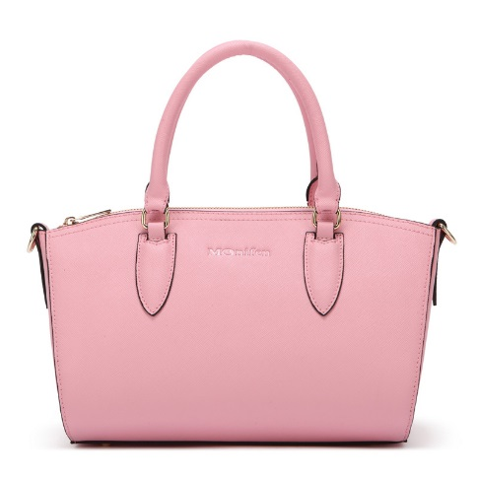
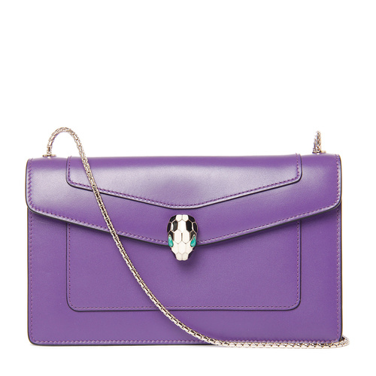
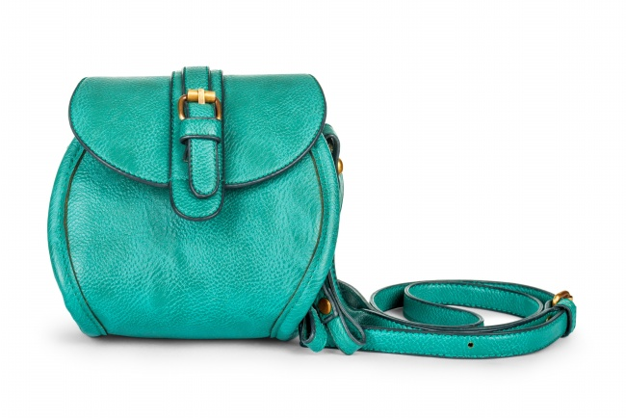
￥ 150.00
￥ 230.00
￥ 400.00
The green bag is ____________ one of all the bags.
the cheapest
The purple bag is __________________ one of all the bags.
the most expensive

Slide 32
Fill in the chart.
 | 原级 | 比较级 | 最高级
regular(规则) adj./adv.
irregular(不规则) adj./adv.
expensive
comfortably
interesting
more expensive
most expensive
more comfortably
most comfortably
more interesting
most interesting
good/well
bad
better
best
worse
worst

Slide 33

Think of three stores that sell similar things in your town and fill in the chart. Then write six sentences using the information in the chart.
Service | best: | worst:
Quality | best: | worst:
Prices | cheapest: | most expensive:

Slide 34

1. New World has the best service in town.
2. ______________________________________
3. ______________________________________
4. ______________________________________
5. ______________________________________
6. ______________________________________
New World is the most expensive in town.
Pink Rose has the worst service in town.
Pink Rose has the best quality in town.
Bargain House has the worst quality in town.
Bargain House is the cheapest in town.

Slide 35

A: Which do you think is the best restaurant near your home?
B: …is the best restaurant.
A: Why?
B: Because it’s the closest to my home, only five minutes on foot. And the service is the best. There are many kinds of seafood, and I like seafood very much.
A: But I think it’s very expensive.
B: Yes, but I don’t order a lot of food.

Slide 36

Make a survey and do a report.
Names | Service | Quality | Prices
Meet all
Carrefour
Walmart
Report: What do you think of these supermarkets in your city? We did a survey and this is what we learnt …

Slide 37


1. I think 970 AM is pretty bad.
我认为调幅970兆赫相当差。
pretty adv. 非常；很 (与very同义)
e.g. The house has four bedrooms, so it’s pretty big.
【拓展】
pretty adj. 漂亮的 (与beautiful同义)
e.g. Mrs. Green’s daughter is pretty.

Slide 38
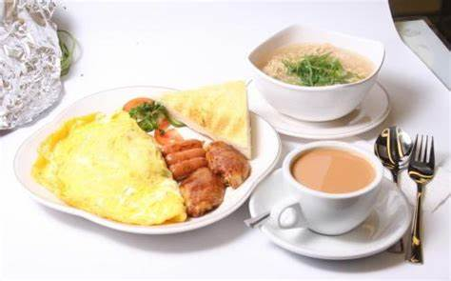
2. How much is a meal? 一顿饭多少钱？
meal n. 早(或午、晚)餐; 一餐所吃的食物
e.g. Breakfast is the first meal in a day.
Mother is preparing a meal for us.

Slide 39
3. 部分副词可以由形容词变化而来，规则：
大多数形容词后直接加-ly可变成副词
e.g. cheap → cheaply careful → carefully
beautiful → beautifully serious→ seriously
以辅音字母加-le 结尾的形容词要先去掉e，然后再加-y
e.g. comfortable → comfortably simple → simply
terrible → terribly
绝大多数以-e结尾的形容词直接加-ly
e.g. polite → politely wide → widely

Slide 40
少数以-e 结尾的形容词要先去掉e，然后再加-ly
e.g. true → truly
以-y结尾且y的发音为 / ɪ / 的形容词要先变y为i，然后再加-ly
e.g. easy → easily happy → happily healthy → healthily
以-y结尾且y的发音为 / aɪ /的形容词直接加-ly
e.g. shy → shyly
有些形容词的副词形式比较特殊
e.g. good → well

Slide 41
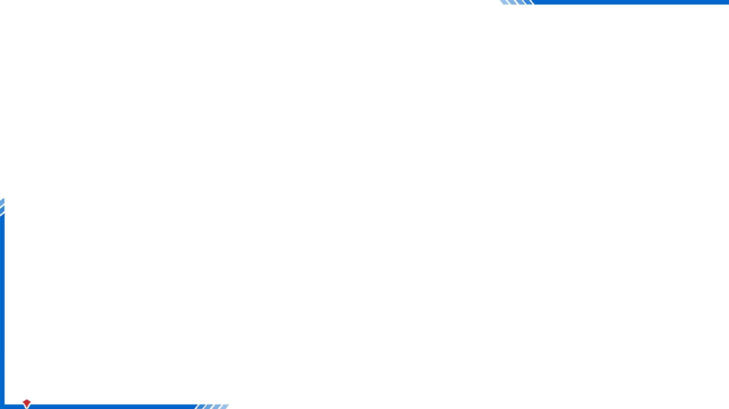

What’s the best movie theater to go to?
Town Cinema. It’s the closest to home.
And you can buy tickets the most quickly there.
Which is the worst clothes store in town?
Dream Clothes. It’s worse than Blue Moon. It has the worst service.
I think 970 AM is pretty bad. It has the worst music.

Slide 42

I. 根据句意及所给首字母提示, 补全句中所缺单词。
1. I enjoy the food in Bluefish Restaurant, but the s_______ there is really bad.
2. May I take your order? And here is the m_____.
3. Breakfast is the first m______ of the day.
4. The man a______ a friendly teacher in the film. His students all loved him.
5. The weather was bad yesterday and it’s getting even w______ today.
service
menu
meal
acted
worse

Slide 43

Ⅱ.用括号内所给单词的适当形式填空。
1. My father is much __________(busy) than my mother.
2. I think English is __________________(interesting) of all the subjects.
3. This hotel has _______________(friendly) service in town.
4. I speak English ___________(bad) than he does.
5. English is one of ________________subjects at school. (difficult)
busier
the most interesting
the most friendly
worse
the most difficult

Slide 44
III. 根据短文内容及括号内所给汉语提示补全短文。
Richard thinks (1)_____________________________(他是世界上最幸运的男孩). He has wonderful parents, loving grandparents, a lovely sister and a smart brother. Richard is always happy.
One day his mother gave him some money to buy ice-cream. (2)_____________________________________________(当他来到镇上最好的冰激凌店时), he saw a man outside it. He looked hungry and was wearing very old clothes and terrible sunglasses (太阳镜). Richard looked at the ice-cream in the shop and then looked at the man. He decided not to buy the ice-cream but to give the money to the poor man.
he is the luckiest boy in the world
When he arrived at the best ice-cream shop in town

Slide 45
The man smiled and said, “Thank you very much. But I’m not a poor man. In fact, (3)______________________________________
_______(我比镇上的任何人都有钱). I just wear old clothes to see how people treat (对待) me.”
(4)_________________________________________________(那个男人带Richard到镇上最大的商店) and said to him, “Choose anything you like. (5)____________________________________
___________(它可以是商店里最贵的东西) as long as you want.”
I have more money than any other person
in town
The man took Richard to the biggest shop / store in town
It can be the most expensive thing in the
shop / store

Slide 46
Richard asked, “Can I choose two?”
“Of course,” answered the man.
(6)___________________________________________(Richard挑选了两副最新的太阳镜). One was for himself and the other one was for the man.
Richard chose two pairs of the newest sunglasses

Slide 47


Write a short passage about your survey of supermarkets in your city.
Preview Section B 1a-1e.

